Slide 1



MP Tech Innovation Challenge 2019
-Organized by RGPV,CII & Young Indians, Bhopal

Slide 2
A Presentation on "Topic" E-GARBIN
Kalaniketan polytechnic college jabalpur
Rahul Chelani
Bipin Pal
Satvik Pare
Surendra Rajput
GUIDED BY:DR. JYOTI GUPTA

Slide 3
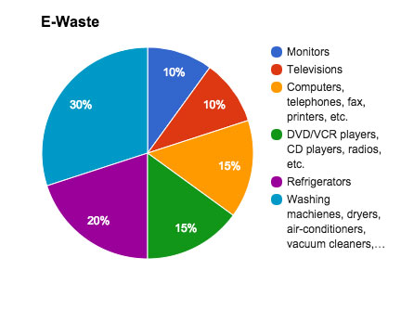
Need Identification
WHAT’S E-WASTE
E-waste has been defined as “waste electrical and electronic equipment, whole or in part or rejects from repair process, which are intended to be discarded”.

Slide 4
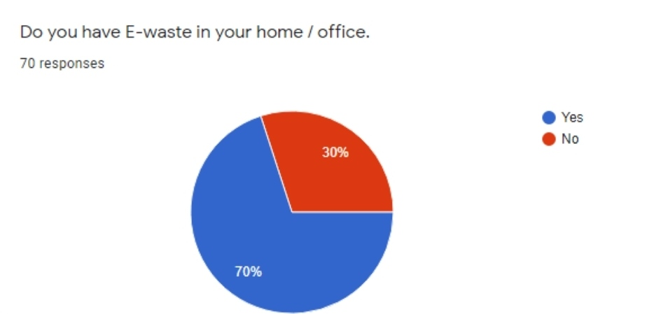
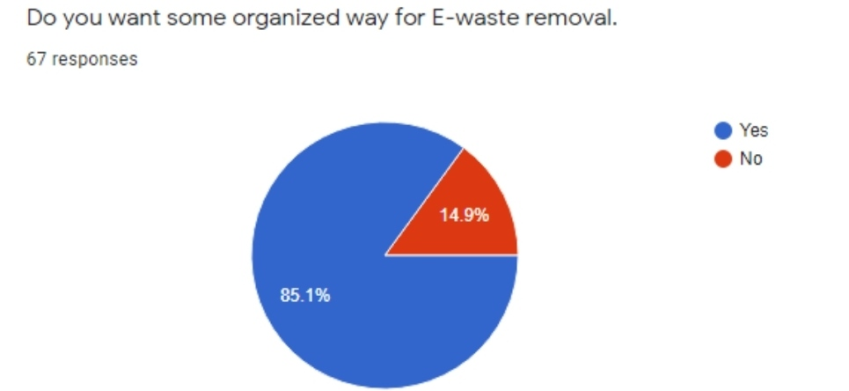
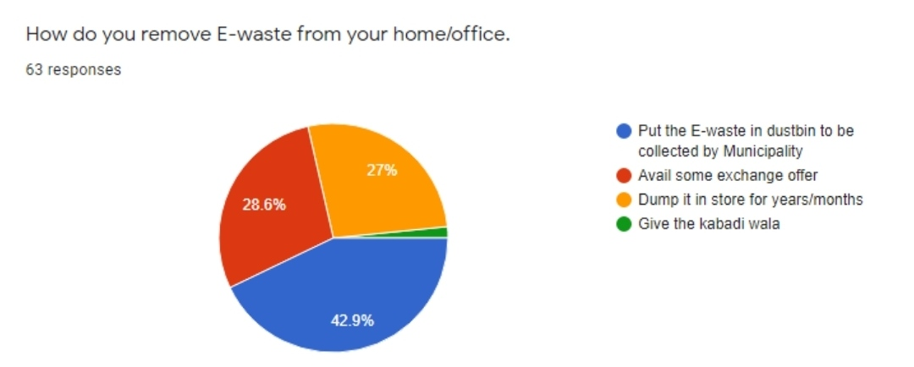
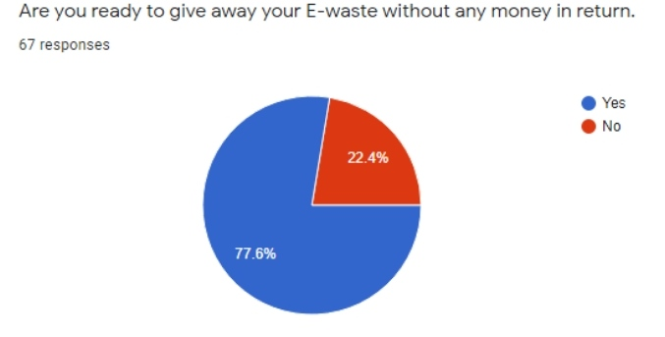
Survey on Domestic E Waste Management

Slide 5

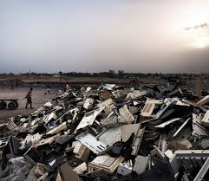
Problem analysis
We performed a survey in our city by using Google forms.
The analysis of survey shows that E Waste is lying in every home & office.
The main problem is collection of E Waste.
E-Waste is generated approx. twice every year in each Customer’s home.

Slide 6
The Project/Innovation
THE PROJECT
“E GARBIN” is a project which is working for E-waste management.
“E GARBIN” works for electronic equipment consumers. We tell people what is E-waste, we tell people about hazards of E-waste
We Collect E-waste from homes and offices on call basis.
INNOVATION
We are using interactive WEBSITE for enquiry and logistic.
We give people e-vouchers to motivate them to remove E-waste from their homes which they can redeem from specified shops.
We also give admiration certificate to those people who give away E-waste free of cost.

Slide 7
Technical Aspects of Innovation
Our model works on collection of E Waste on call basis.
We have used IT Service ,i.e WEBSITE for registering enquiry and logistic for collection of E Waste.
Collection process is tracked by CALL ID.
We send auto SMS for acknowledgement.
We send E VOUCHER through SMS.
We send E CERFICATE through email.

Slide 8
The Working Model/Practical Aspect
.As mentioned we have created a Website which is working between team E-garbin and a Consumer.
.We ask people to visit our website and request us for pick up by filling enquiry form.
.Then the CR will contact the costumer within 24 hours of their request.
.The CR will visit the home/office and get the E-waste pick up.
.We will also offer them E-voucher or E-certificate for their positive support towards environment.

Slide 9
Prospects of Commercialization(Includes Costing of Project & Marketing Plan)
E-Garbin is a no-profit no-loss project, which works for safety of environment.
With help of Jabalpur Smart city, it becomes more successful.
The CRs will be paid on commission basis.
Our college management has provided us a Store House for collected e-waste in our college campus.
The given E- vouchers can be redeemed at the specific shops for 10% -15% discount.
The Recycler will pick the collected E-waste every after the limit is reached.

Slide 10
COSTING OF PROJECT
INITIAL COST INCLUDES
1.Website Development and hosting
2.Publicity
RECCURING COST
1.Payment of CR
2.Publicity
3.Rent for store house
FUND RAISING
1.From smart city OR Nagar Nigam
2. Donation
MARKETING
PUBLICITY
Advertisement on radio FM supported by Nagar Nigam or smart city
Audio stream played by daily solid waste collection vans.

